Slide 1

Software Design and architecture (SE322) gg
Week 13
Said Nabi
said.nabi@giki.edu.pk
Faculty of Computer Science and engineering
Gik Institute Topi, Swabi

Slide 2
List of Topics
Architectural Styles i-e Modular Monolithic, Microkernel and Client Server Architecture

Slide 3
Modular Monolithic Architecture
A Modular Monolith is a single deployable application composed of multiple, well-defined business-aligned modules.
Each module encapsulates its own domain logic, data access, internal services, and rules, exposing only a controlled public API.
Although the system runs as one process, its internal structure behaves like a collection of independent components, providing strong modularity without the operational complexity of distributed systems like microservices.
The architecture exists to overcome the fragility of traditional monoliths, which often devolve into tightly coupled, hard-to-change systems, and to avoid the heavy operational burden of microservices, such as network latency, distributed transactions, and increased failure modes.
A Modular Monolith balances both extremes by offering clear separation of concerns, maintainable boundaries, and development velocity while keeping deployment and runtime simple.

Slide 4
Modular Monolithic Architecture Cont..
A modular monolith is built from strictly bounded modules owns its business logic and data.
Modules encapsulate their entities, services, and repositories, exposing only explicit APIs or domain events. Communication happens through fast in-process calls or asynchronous events, giving flexibility without distributed-system complexity.
Each module exclusively owns its database tables, with other modules accessing data only through controlled interfaces or projections.
This architecture offers fast development, simple debugging, ACID transactions, clear ownership, and autonomy without the operational burden of microservices. Its challenges include enforcing boundaries and scaling at the application level rather than per module.
Unlike a layered monolith, it organizes code around domain capabilities, creating cleaner cohesion and serving as a strong foundation that can later evolve into microservices if needed.

Slide 5
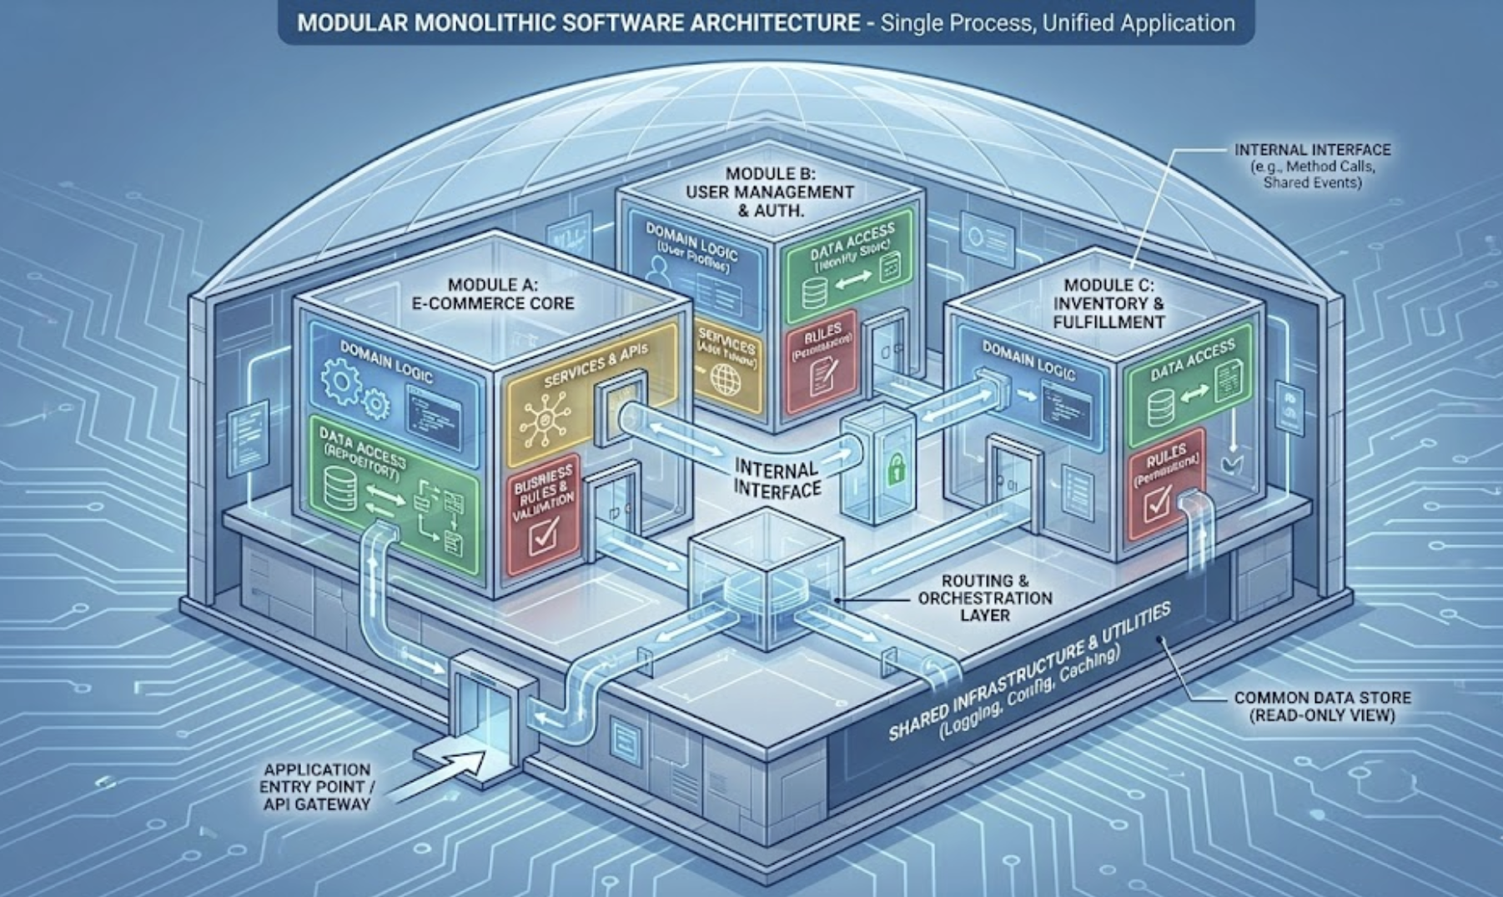

Slide 6
Microkernel Monolithic Architecture
The microkernel architecture style defines a way of building software wherein the system is packaged and deployed as a single application (so, monolithic in deployment), yet its internal structure provides a clear separation between a minimal stable core and optional, independent plug-ins.
This gives the codebase the advantage of modularity — each plug-in encapsulates special functionality or business logic, while the core stays simple, robust, and stable.
The core holds only what is strictly necessary for the system to “boot up” and provide the foundation: general workflows, basic life-cycle, core services.
All domain-specific logic, customization, and variability are offloaded into plug-in modules.
This separation supports extensibility: new features, modules, or business‑specific rules can be added without disturbing or risking the stability of the core.
Microkernel architecture keeps monolithic deployment simple while enabling modular features and easy customization, ideal for flexible applications.

Slide 7
Microkernel Monolithic Architecture Cont..
The core system itself need not be simplistic — it can be internally organized with another architecture style, as appropriate to the problem domain.
This flexibility ensures that the core remains manageable, while plug-ins cleanly encapsulate custom behavior.
Importantly, plug-in components should avoid depending on each other; they should depend only on the core system.
This minimal coupling ensures isolation and simpler maintenance: one plug-in can be developed, tested, replaced or removed without affecting others.
Communication between core and plug-ins typically relies on well‑defined interfaces, keeping the system coherent while decoupling modules.
Microkernel architecture avoids distributed-system complexity, combining monolithic simplicity with modular flexibility, offering a practical middle ground between monoliths and microservices.

Slide 8
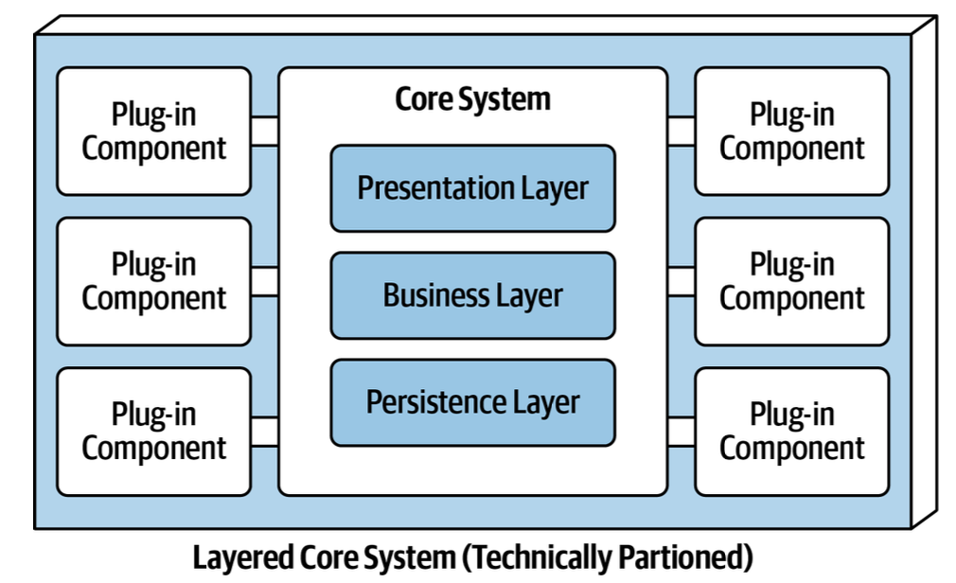
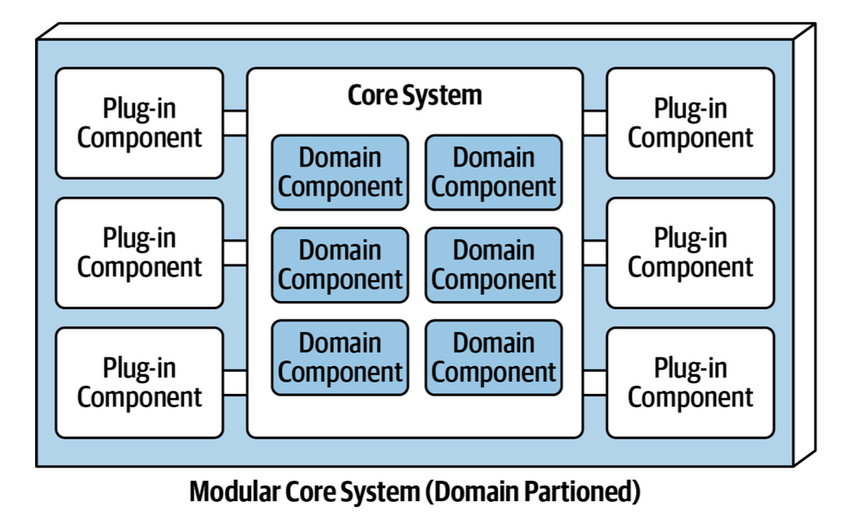

Slide 9
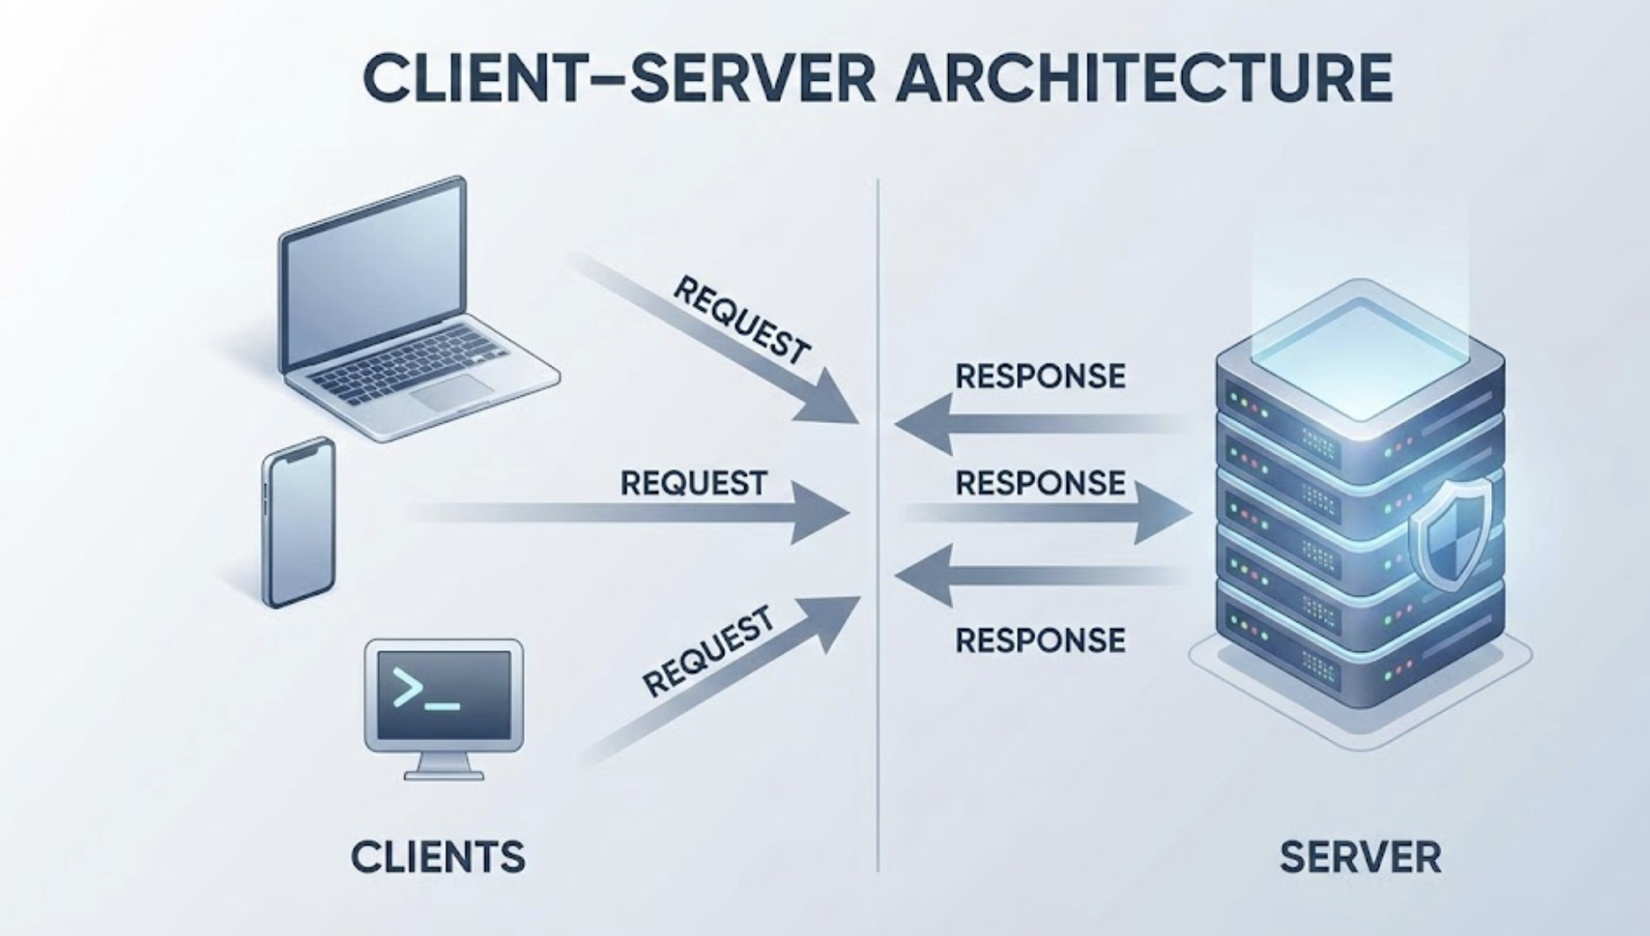

Slide 10
Client Server Architecture
Client–Server Architecture is a distributed computing model in which responsibilities are separated between two independent components: the client, which requests services, and the server, which provides them.
Instead of placing all processing, data handling, and user interaction inside one large monolithic program, this architecture spreads the work across machines or processes connected through a communication channel such as TCP/IP or HTTP.
The client focuses primarily on presenting information and collecting user input, while the server manages processing logic, security enforcement, and centralized storage.
Because the two components communicate through structured request–response interactions, this architecture supports distributed systems where clients can operate anywhere
—from desktop computers to mobile devices
—while the server remains the authoritative provider of data and services.
This architectural approach enables scalability, easier maintenance, and centralized control, making it suitable for large, multi-user environments.

Slide 11
Client Server Architecture Cont..
Client–Server Architecture allows servers to handle many requests at once, making it easy for organizations to grow by adding more clients or improving server capacity.
Centralizing updates, security, and data on the server simplifies management and keeps all clients consistent, but this also creates risks—if the server fails or the network is slow, the entire system can be affected.
Despite these challenges, the clear separation of responsibilities makes client–server systems more organized, secure, and scalable than monolithic setups.
This architecture remains a core model in modern computing, forming the foundation of websites, mobile apps, databases, games, and cloud services.
Even advanced architectures like microservices and cloud-native systems still build on the same client–server principles, making it essential for understanding modern distributed applications.

Slide 12
Client Server Architecture’s types
1-Tier Architecture keeps everything—UI, logic, and data—on one machine, like a calculator app or offline Excel.
In 2-Tier Architecture, the client talks directly to a server or database, such as old desktop apps sending SQL queries to a university database.
3-Tier Architecture adds an application server between the client and database; for example, a React frontend → Node.js/Java backend → Database, used by e-commerce and banking apps.
Large-scale systems use N-Tier Architecture, adding layers like API gateways, authentication, caching, and microservices, similar to Amazon, Netflix, and Google.
In Peer-to-Peer Architecture, every device is both client and server, as in torrent networks or blockchain.

Slide 13
Thank You☺

